Slide 1
POSITIVE BEHAVIOUR FOR LEARNING
Wellbeing@School - website and toolkit
27 April 2012

Slide 2
www.wellbeing@school.org.nz available to schools on 7 May 2012 Building a safe and caring school climate that deters bullying (Former name: Safe School Climate)
Wellbeing@School Website
Notes:
The full name of W@S is…..
This shows the focus of the W@S tools and processes and has been selected to indicate that we are focused on the SOCIAL aspect of wellbeing.
Former name……

Slide 3
A way of working: The self-review cycle
Reviewing & improving (Re-using W@S tools to chart change)
Planning & preparation (Putting in place a review team)
Gathering data & assessing needs (Using the W@S tools)
Taking action
Next step planning (Using W@S reports & modules)
Notes:
Wellbeing@School is baded on a self-review cycle. To model the idea that the tools need to be used within an overall process we have designed a self-review cycle that surrounds the use of the tools …
Longer-term studies of anti-bullying interventions often show short term success, followed by a return to previous behaviours over-time. For this reason we have grounded the use of the W@S tools in a self-review process that is designed to be cyclical and long-term (and managed by schools so they have ownership over it).
This process has 5 steps. We are using it to structure the W@S website. E.g., schools will access at Step 1 XXX

Slide 4
Wellbeing@School: Building a safe and caring school climate that deters bullying
Step One: Planning and preparation
The two key parts of a whole school approach are:
a way of thinking about schools as a multidimensional and interactive system
a process for change in schools that involves all community members working together.

Slide 5
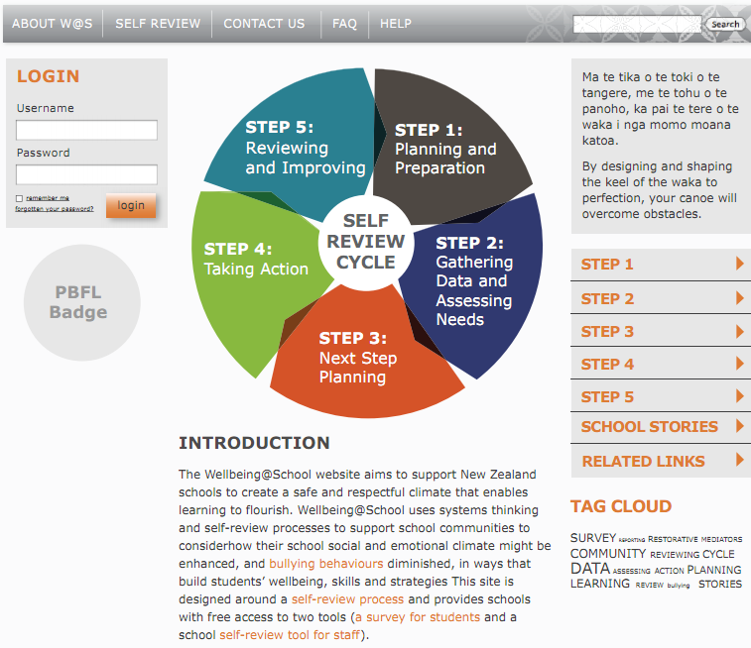
Wellbeing@School: Building a safe and caring school climate that deters bullying
Notes:
The website is designed to provide sufficient information to support the tools – and to connect (or link) to further related information.
A school will need to register before they can use the tools – this is because they will need to agree to terms of use and have an account that stores their data securely.

Slide 6
Wellbeing@School –school administration
Notes:
Shot of School administration area – explanation of icons on next slide

Slide 7
There are a number of functions available for surveys in the Current survey list:
Downloadable version of the survey
(Student Survey, Teacher Survey or School Self-Review Tool);
Survey administration: link to the survey, sending emails, archiving the survey, adding classes and data entry function (for the Student Survey).
or Access to the survey – can turn access off/on for each type of survey
Done: The number of surveys that have been completed.
Summary reports: shows the summary reports for the survey results.
Archive survey icon
Delete survey – you can delete a survey only if it is empty
Wellbeing@School – Step One : Planning and preparation
Explanation of dashboard

Slide 8
Wellbeing@School: Building a safe and caring school climate that deters bullying
Step Two: Gathering Data
Keypoints about using the Wellbeing@School tools to collect data
Use the W@S tools together to build a picture of students and staffs view of school practice
The W@S tools can be used to provide needs assessment and baseline data
Self Review and needs assessment data is best gathered from more than one source
This data can be used to start discussions and raise awareness about how different groups view the school
Develop a plan for how data will be collected over time

Slide 9
Wellbeing@School: Step 2 –Gathering Data
Two data gathering tools (online & hardcopy):
Student Survey (2 parallel versions)
School Self Review Tool (SSRT)/Teacher Survey
Support for the tools (reporting, scoring)
Next step modules (resources, information)
Self-review cycle
Self-review cycle
Notes:
In response to the initial brief, we are designing a website that offers these services for schools.
1) 2 tools (SS and SSRT – an audit of school practice intended to be completed by a review team) XXX
2) Support for the tools (reporting for schools)
3) Next step modules (reports will show areas of strength and possible next steps). Modules link schools to evidenced-informed approaches to plan approaches and address next steps.
4) We have designed the site so that the tools and support are offered within the framework of a self-review cycle

Slide 10
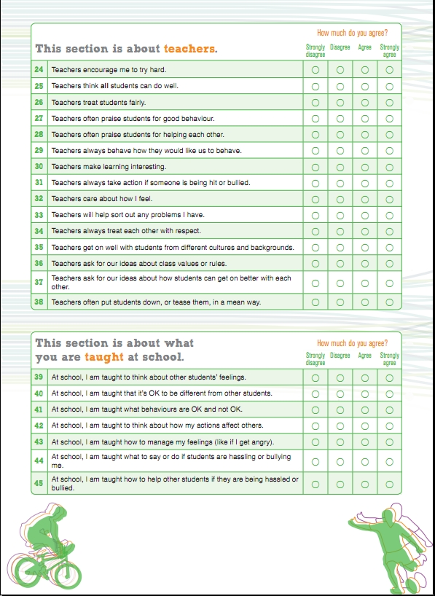
The Student Survey
Survey versions
Year 5-8 (Primary)
Year 7-13 (Intermediate & Secondary)
Survey process
Completed by class groups online or in hardcopy
Online reports show combined student data and sub-groups (e.g., year level, gender, ethnicity, class)
The student survey is….
designed to collect students’ perspectives on different aspects of school life
Notes:
XX
Student Survey (copy of survey to be provided). Takes about 20-30 minutes. Two surveys
Two student surveys to select from: Primary/Intermediate and Intermediate/Secondary

Slide 11
The Teacher Survey
Survey process
Collects data on teachers’ perspective about school life
Completed anonymously
Is a subset of the questions in the School Self Review Tool (SSRT)
The teacher survey….
data is used by the review team to complete the SSRT

Slide 12
The School Self Review Tool (SSRT)
Suggested SSRT steps
The school assembles a review team (e.g., school leaders, teachers, students, BoT rep) and introduces the W@S process to all staff at a professional learning session
All teaching staff invited to complete the shorter anonymous Teacher Survey.
Teacher Survey results then used by the review team to complete one copy of the SSRT online.
Online report produced from the SSRT to show different aspects of school life. A summary report from the Teacher Survey is also available.
The SSRT process…is designed to involve all staff and encourage debate and self-review
Notes:
SSRT survey is attached.

Slide 13
Wellbeing@School: Building a safe and caring school climate that deters bullying
Wellbeing@School: Step 2 –Gathering Data
Wellbeing@School: Step 2 –Gathering Data
Step Three: Plan Steps
The W@S reports explore four different dimensions (aspects of school life) that the research literature suggests work together to create a safe and caring climate which deters bullying. These aspects are:
Whole school climate and practices
Teaching and learning
Community partnerships
Pro social student culture and strategies
A fifth aspect explores the extent to which aggressive and bullying behaviours occur at school. This aspect is called
Aggressive student culture

Slide 14
Wellbeing@School: Building a safe and caring school climate that deters bullying
Step Three: Plan Steps
There are three different types of report for W@S. Each has a slightly different purpose. They are:
School Overview report (School at a Glance) – aims to give a starting point to exploring data in more depth
Aspect reports are produced for the Student Survey only. Aspects at a Glance provides an overall picture and Aspects in Detail provides detail of single aspects
Item reports provide a summary of how groups of teachers or students responded to each survey statement.
Notes:
Snapshots of reports follow

Slide 15
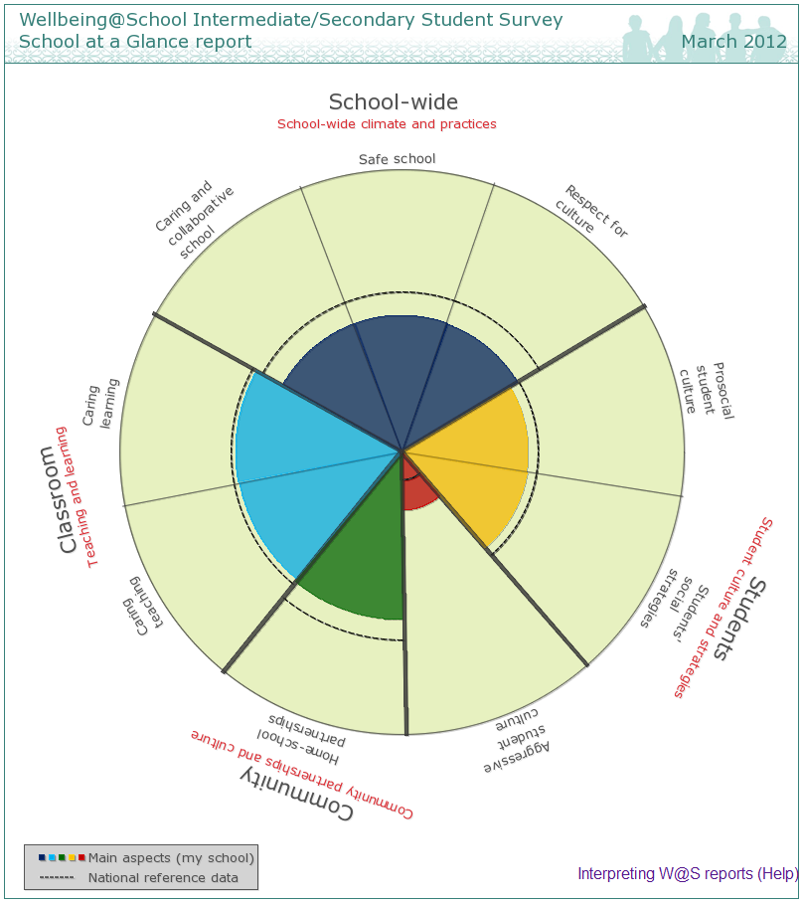
Notes:
These circular reports are designed to represent each school as a system with different dimensions (called aspects). The reports give a broad overview of the W@S data by aspect and sub-aspect. They can be used as a starting point to look for patterns or differences that can then be explored more fully in the more detailed report types. The Student Survey report displays national reference data¹ for relevant year levels.

Slide 16
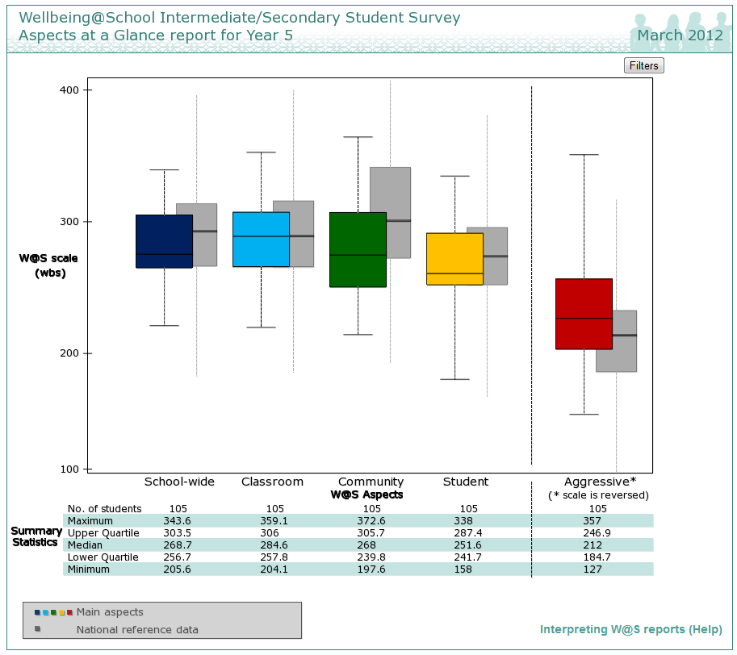
Notes:
There are two types of the Aspect reports: Aspects at a Glance and Aspects in Detail. These box plot reports are produced for the Student Survey only. Aspect reports can be viewed as:
an overall picture (all aspects on one report – Aspects at a Glance report), or by
single aspects with their associated sub-aspects (Aspects in Detail report).

Slide 17
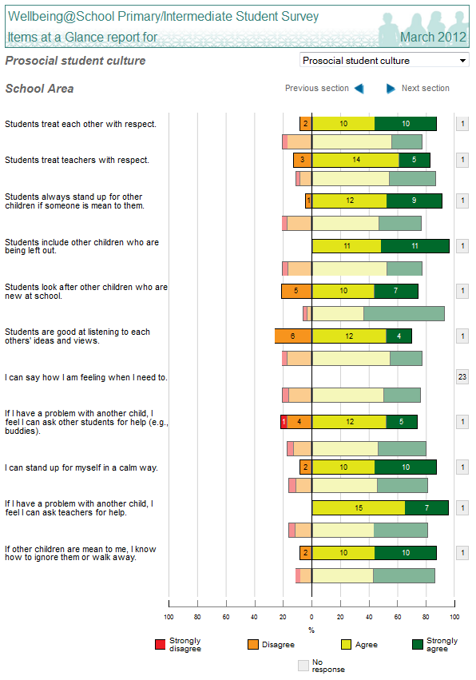
Notes:
Each report displays the survey statements used in the section on the left hand side of the page. Next to each statement is a strip graph showing the proportion of students or teachers who chose each of Strongly disagree, Disagree, Agree, and Strongly agree. For the aspect, Aggressive student culture, the responses are: Never or hardly ever, 1 or 2 times a year, 1 or 2 times a month, 1 or 2 times a week, and Almost every day.

Slide 18
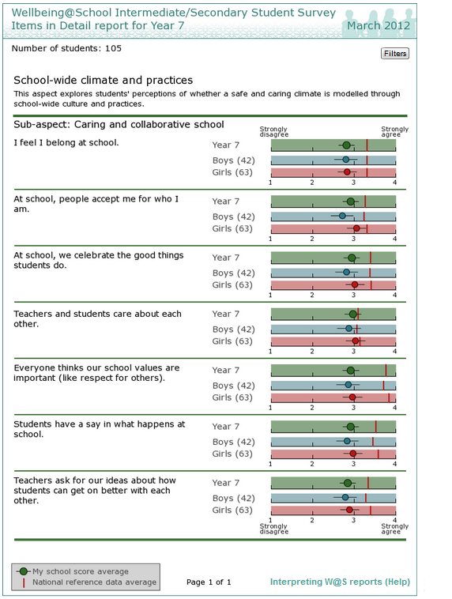
Notes:
There are two types of Item reports: Items at a Glance and Items in Detail. These strip graphs provide a summary of how groups of teachers or students (Items in Detail only) responded to each survey statement. A number of different Item reports can be generated for:
students, based on the aspects (Items at a Glance report)
In Items in Detail reports, survey statements are displayed as in the other item reports, this time accompanied by a series of strip graphs showing the average response of students in the relevant group or sub-group. See Figure 6.
A vertical line on each strip indicates the reference group mean for the relevant item.
teachers, based on the questions and sections of the survey (Items at a Glance report); and
students, based on the aspects and sub-aspects (Items in Detail report). This report can show gender, Year level information and national reference data, and can be filtered by ethnicity.

Slide 19
Notes:
Each report displays the survey statements used in the section on the left hand side of the page. Next to each statement is a strip graph showing the proportion of students or teachers who chose each of Strongly disagree, Disagree, Agree, and Strongly agree. For the aspect, Aggressive student culture, the responses are: Never or hardly ever, 1 or 2 times a year, 1 or 2 times a month, 1 or 2 times a week, and Almost every day.

Slide 20
Two W@S resources are designed to assist in this. These are the:
W@S Action plan template: This Word Document is designed for schools to adapt. It provides a format to support schools to consider goals, actions, resources, and how change will be assessed.
W@S Next step modules: These resources are designed to support schools to plan next steps. Each module offers suggestions for next step activities linked to each W@S aspect.
Developing an Action Plan

Slide 21
Wellbeing@School: Building a safe and caring school climate that deters bullying
Step Four: Take Action
Research shows that the processes schools use to implement change are a key factor in determining the success of these changes.
Key actions
Implement new actions thoroughly
Involve the whole community
Ensure staff, students, and the community have adequate learning opportunities
Monitor progress and using formative feedback
Make on-going changes if necessary.

Slide 22
Wellbeing@School: Building a safe and caring school climate that deters bullying
Step Five: Review
Step 5 is about reviewing and reflecting on progress.
During Step 5, schools re-use the W@S tools to collect data to review actions. It is suggested that a formal review of progress happens annually, and a major review after 3-5 years

